Slide 1

School Enrollment & Covid Cases in California by County (2019-2020, 2020-2021)
Presenters: Alexandra Baker, Ludan Zhang, Bryan Carro, Christine Li, Erika Gonzalez

Slide 2
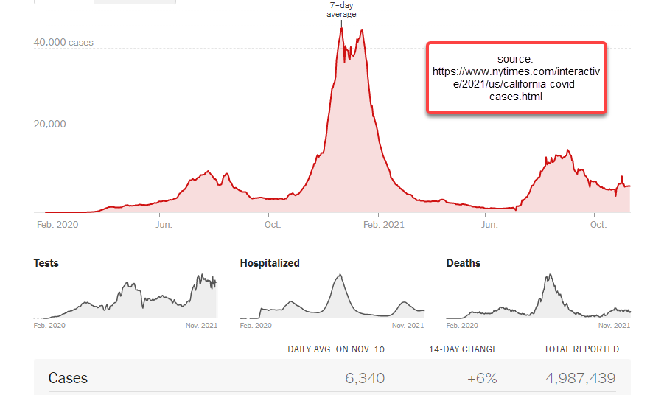
Background
March 2020: After the first death in California of an elderly male, Governor Newsom declared a state of emergency to halt in-person instruction in an effort to stop the spread of Covid-19
Shutdown had a major impact on families
February 2021: Cases have fallen dramatically prompting schools to reopen
Oct 2021: Mandate to have children vaccinated by Jan 2022
CLOSURE
In the United States, K-12 schools closed for in-person instruction as a way to prevent the spread of COVID-19.
February 25, 2021
March 2020
Re-Opening
Some school districts began to open up for in-person instruction, Teachers and school employees were given priority to receive the vaccination
.
2
Notes:
Getting all of this info from edsource.org
Despite Governor Newson calling for a closure of in-person instruction, many schools in rural areas remained open
Impacts include: childcare, ability to afford technology for virtual learning, concerns on falling behind, mental health, etc

Slide 3
Research Questions
What was the significant change of enrollment pre-Covid vs during Covid?
Did enrollment numbers change more for specific demographics?
Is there a correlation between COVID cases vs students enrolled?
3
Notes:
Getting all of this info from edsource.org

Slide 4

Data Breakdown
e
Cleaning the Data
Merge Data
Analysis on Enrollment by
year
Analysis on Enrollment vs.
COVID
4
Notes:
Analyzed on enrollment data across years then on enrollment vs. COVID

Slide 5

Data Cleaning &
Merging
Notes:
please mention Enrollment csv (from CA State GeoPortal), COVID csv (from CA Open Source), Gmaps API

Slide 6
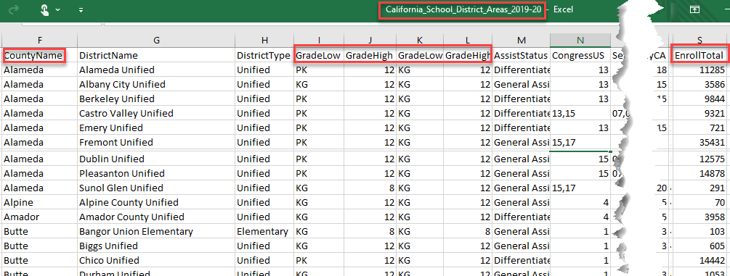
DATA SOURCES
2019-2020
6
Notes:
please mention Enrollment csv (from CA State GeoPortal), COVID csv (from CA Open Source), Gmaps API

Slide 7
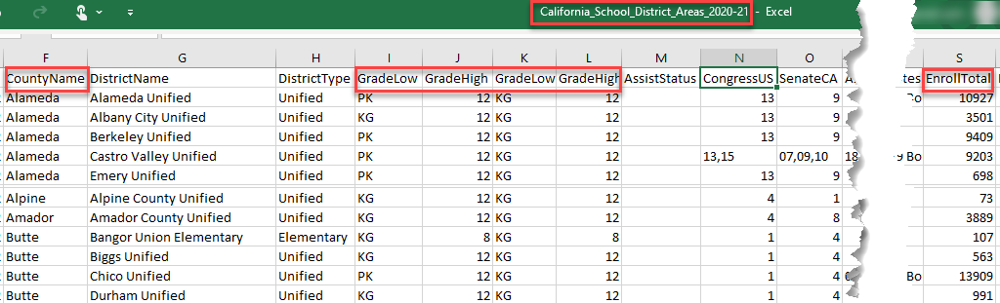
DATA SOURCES
2020-2021
6

Slide 8
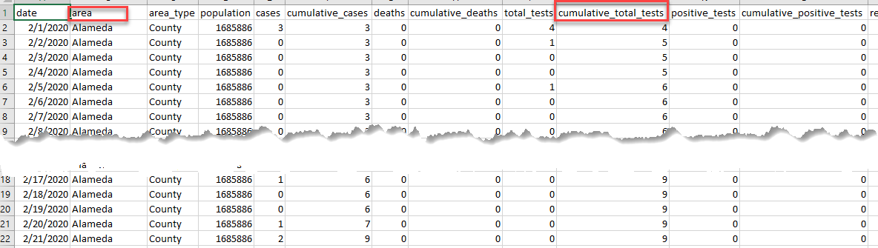
DATA SOURCES
Covid-19 Cases
8

Slide 9
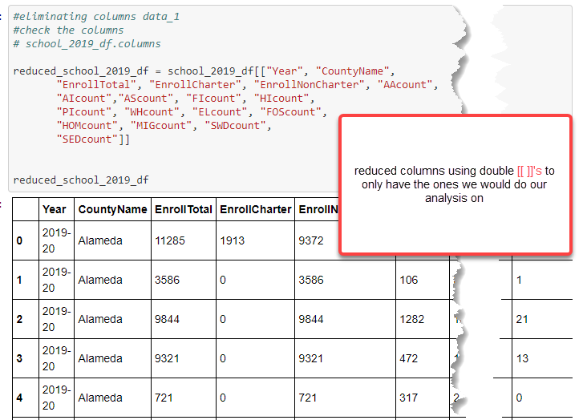
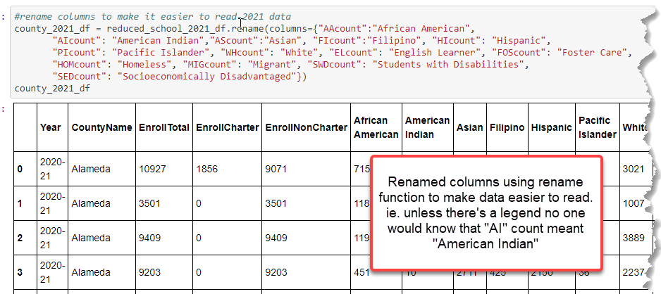
Cleaning Enrollment Data
9

Slide 10
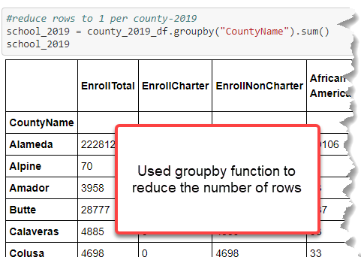
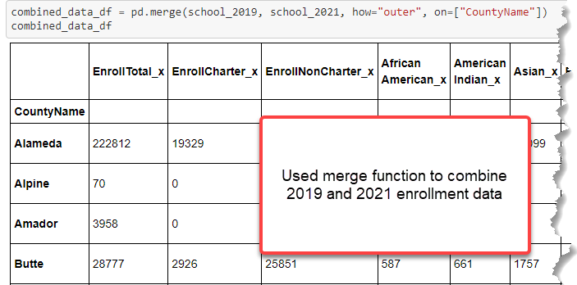
Cleaning Enrollment Data
10

Slide 11
Enrollment Demographics

Slide 12
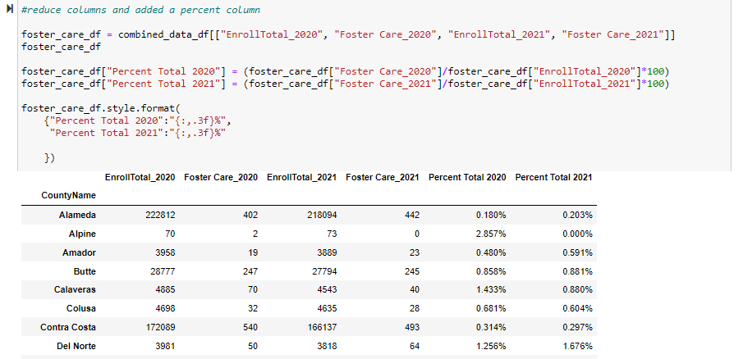
Foster Care
Reduced Columns and added a percent column to get percentage of how many students enrolled in 2020-2021
Graph per county shows that there was no significant change in enrollment per year
12
Notes:
Erika: click enter to make first

Slide 13
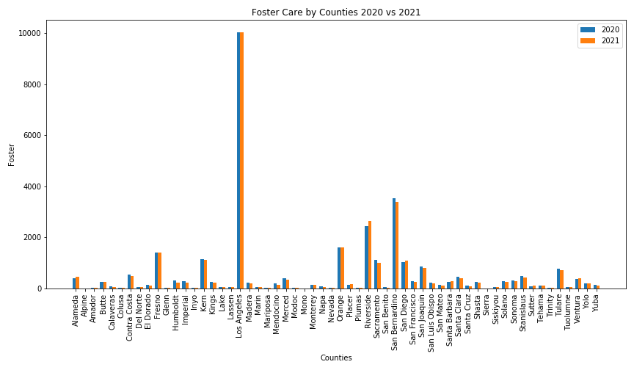
Foster Care
Reduced Columns and added a percent column to get percentage of how many students enrolled in 2020-2021
Graph per county shows that there was no significant change in enrollment per year
13
Notes:
Erika: click enter to make first

Slide 14

Migrant Students
Followed the same process as with the Foster Care data
The graph also indicated no significant changes except between Riverside and San Bernardino County
14

Slide 15
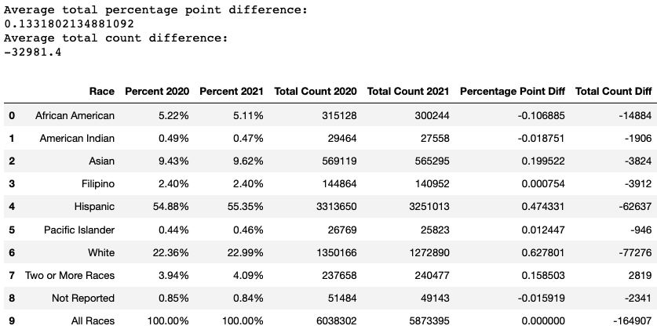
Race/Ethnicity
Percentages by race, total of all counties (pie charts)
Created a stacked grouped bar chart of the total counts of the 4 largest races/ethnicities
15
Notes:
Overall, total enrollment across CA dropped by 164,907 students between the school years 2019-2020 and 2020-2021
That said, change in enrollment by race and by percentage point was negligible for all races
Total counts mostly decreased for all racial groups as reflected by the average total county difference (-32,981)
The percentage point difference was actually slightly positive as reflected in the average percentage point difference (0.13)
Notice that the percentage point difference for African American, American Indian and Not reported went down compared to everything that over all went up

Slide 16
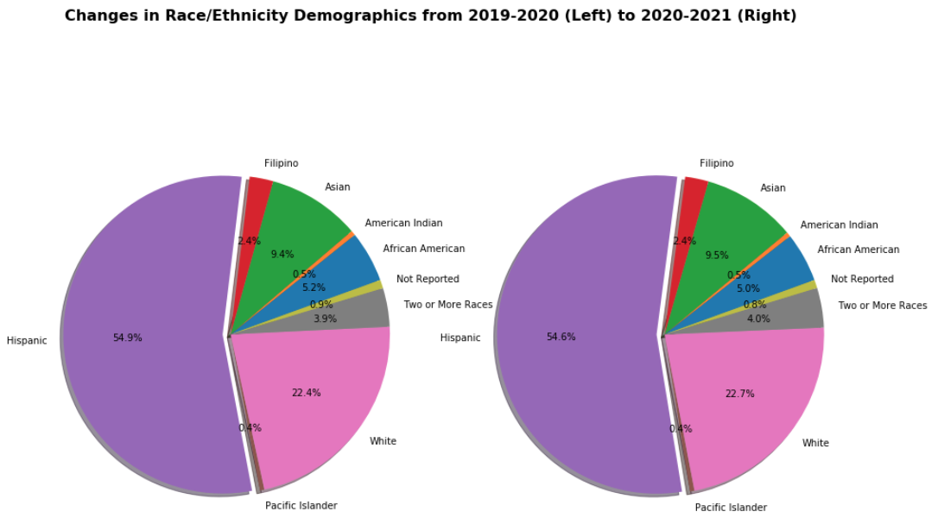
16
Notes:
Proportionally Hispanic, White and Asian are the largest racial/ethnic groups in CA so even small percentage changes in these groups can mean large variations in total population
As you can see in the pie chart, the total changes by racial/ethnic group are negligible (i.e. have to look at the decimals to see a difference) though the actual changes by county might vary widely as seen in the stacked group bar chart on the next slide

Slide 17
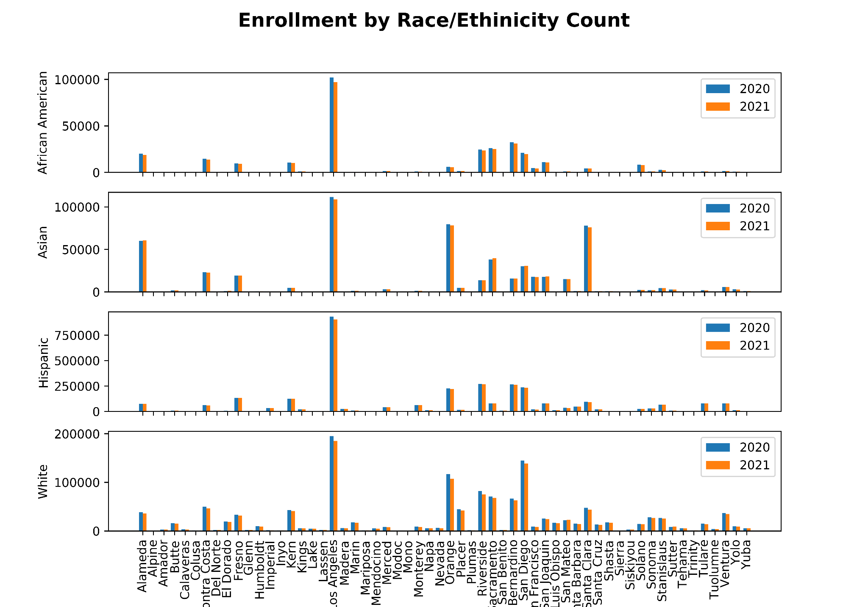
Race
&
Ethnicity
11
Notes:
Here we have stacked, grouped bar charts for the 4 largest race/ethnic groups with Hispanic overwhelmingly being the largest. Notice how different the scale is for Hispanic compared to the other three groups.
You will also see that although, in general, there isn’t too much difference population, there is a more noticeable difference in the more heavily populated counties like Los Angeles, Orange, San Francisco, and San Bernardino
Although we don’t know the exact reason why that might be the case, there are various reasons that could make sense
For example, it could be because of financial factors like the higher cost of living in these counties versus the increasing unemployment and business closures
Anecdotally, a lot of people moved out of Santa Clara and San Francisco counties (some of the most expensive in the state because of the tech industry) and to neighboring counties with cheaper costs of living because of the increasing opportunities to work remotely, another consequence of the pandemic

Slide 18
Homelessness
Counts and Percentages by County
Created a grouped bar chart of all counties 2020 vs 2021
18
Notes:
Comparatively, the decrease in students experiencing homelessness across CA was resoundingly negative in both percentage point difference and Homelessness Count Difference
Thus, we expect this trend to be the same when comparing counties

Slide 19
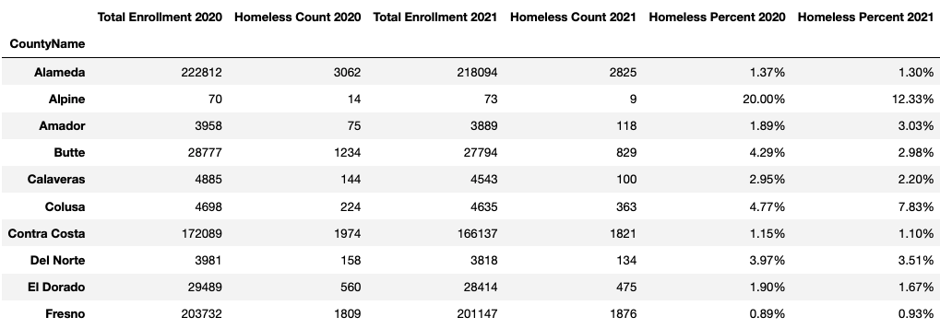
Homelessness
Counts and Percentages by County
Created a grouped bar chart of all counties 2020 vs 2021
19
Notes:
When examining enrollment of students experiencing homelessness we see that it varies by county and while a lot of small changes, some change by a lot like in the case of Alpine county we should see that in the bar chart as well

Slide 20
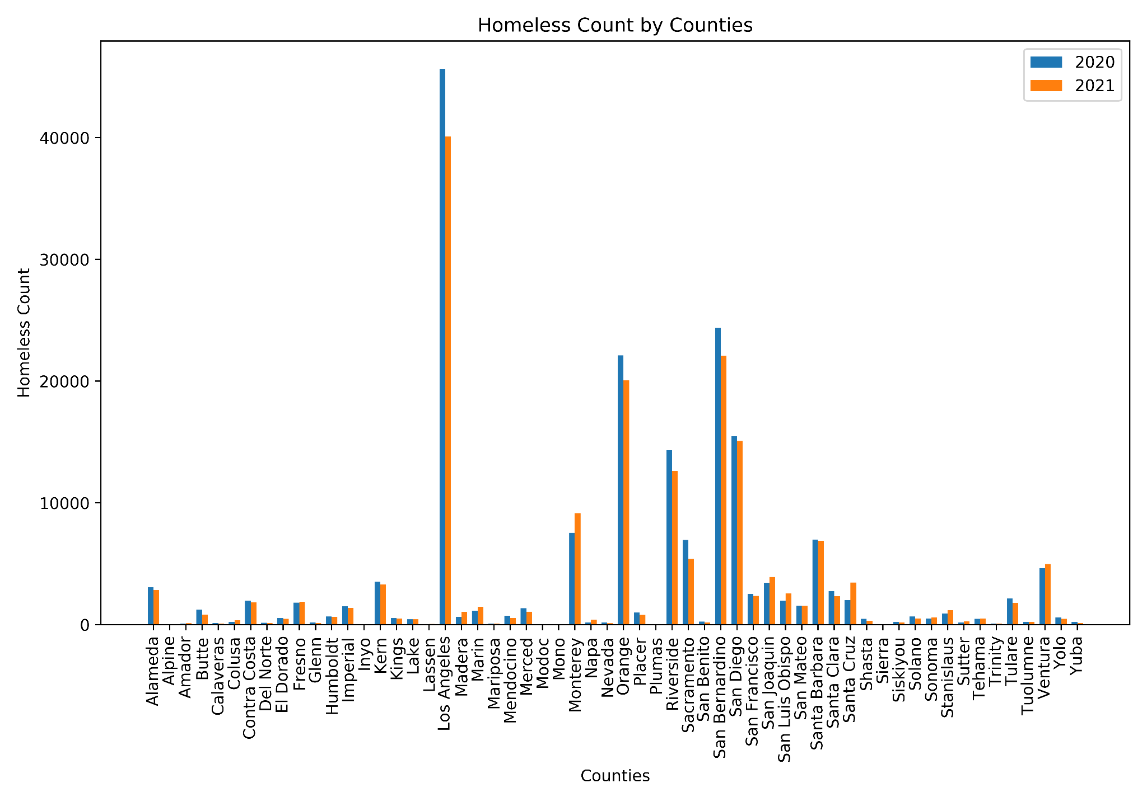
Homelessness
Grouped Bar Chart
12
Notes:
We do see that same trend in the bar chart
In fact, the fluctuations in count are dramatically different for some of the counties with the highest enrollment (i.e LA county)

Slide 21
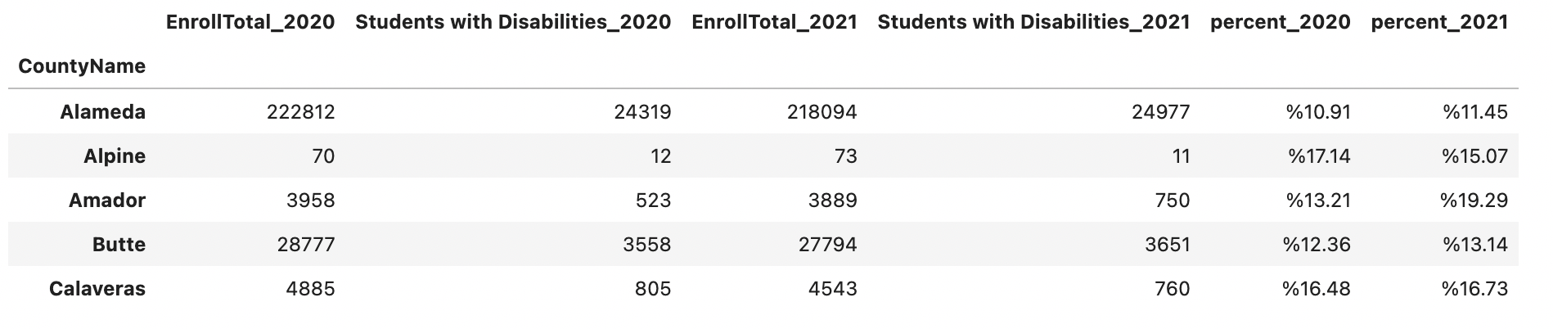
Students with Disabilities
Coded percentages by divided the total number of students with disabilities by total enrollment
Created a stacked grouped BarChart of the total counts of the 4 largest races/ethnicities
From the summary table above, it’s obvious that covid doesn’t not effect the enrollment of students with disabilities significantly. As the percentage of enrollment doesn’t have display a huge difference.
11

Slide 22
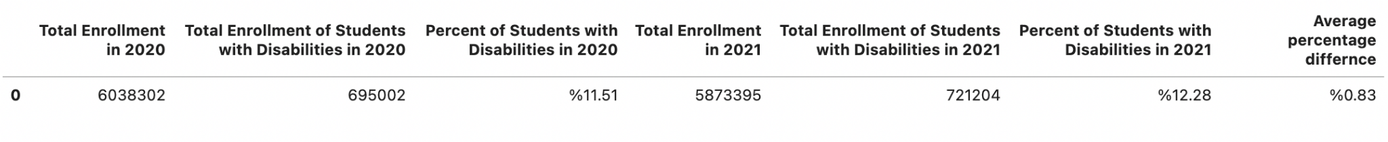
Students with Disabilities
Coded percentages by divided the total number of students with disabilities by total enrollment
Created a stacked grouped BarChart of the total counts of the 4 largest races/ethnicities
From the summary table above, we have the average percentage difference from all counties in California of students with disabilities enrollment percentage is 0.83%.
11

Slide 23
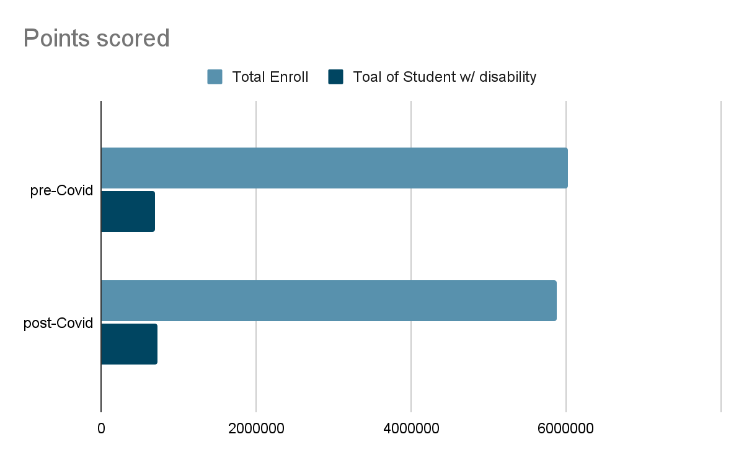
Students with Disabilities Graphic Summary
11

Slide 24
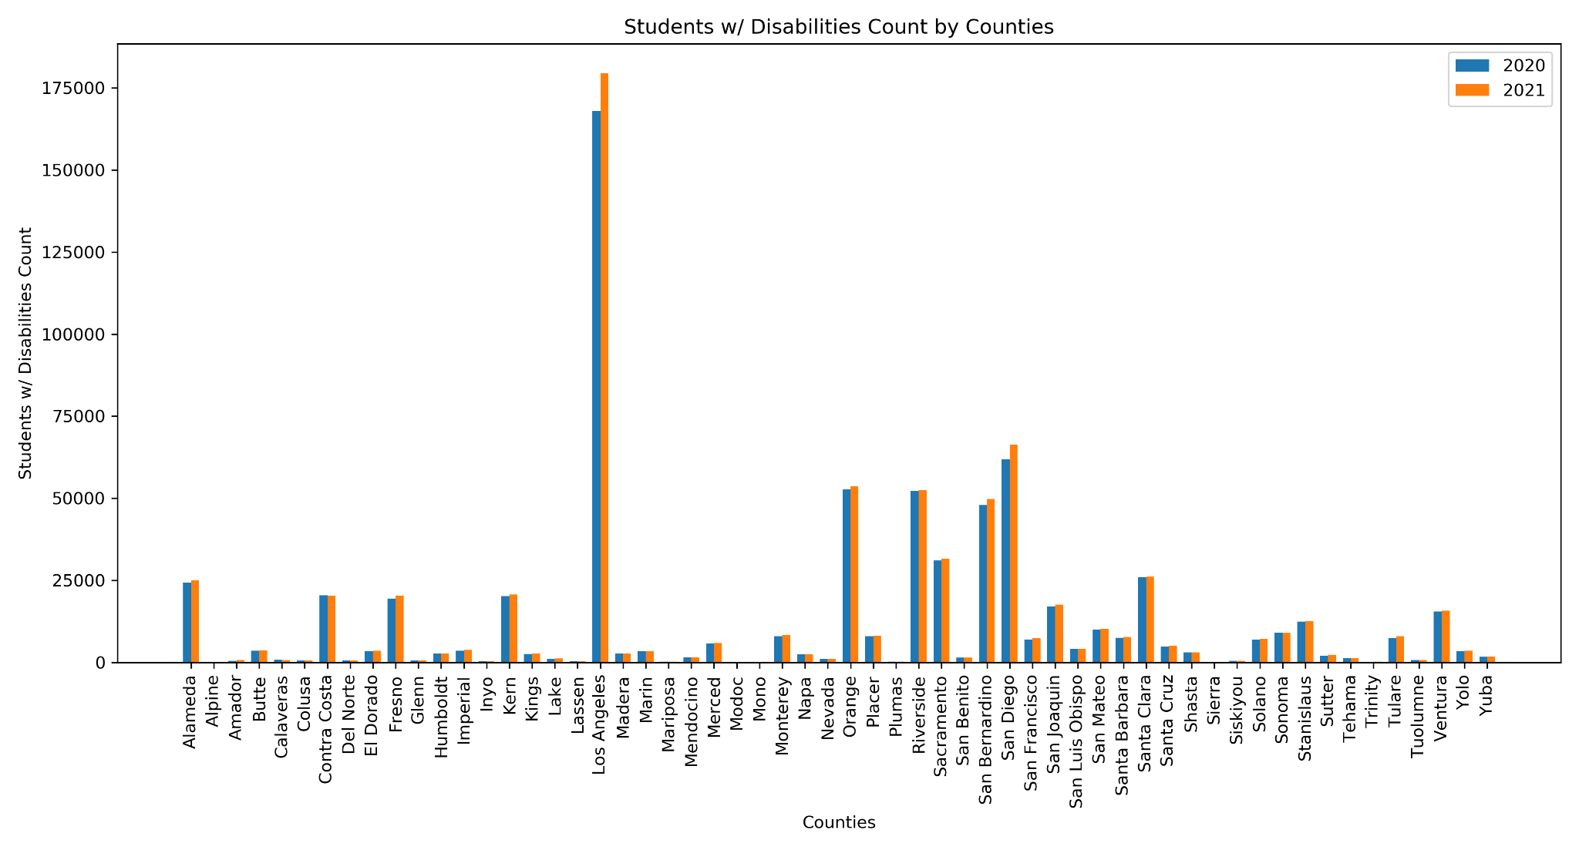
Students with Disabilities Graphic Summary
11

Slide 25
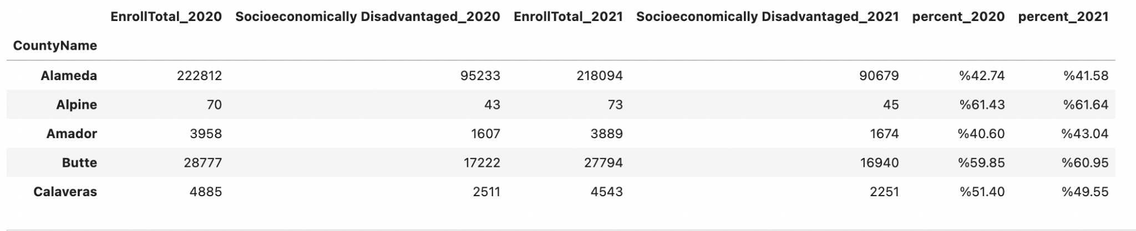
Socioeconomically Disadvantaged students
Summary Table
From the summary table above, it’s obvious that covid doesn’t not effect the enrollment of students with disabilities significantly. As the percentage of enrollment doesn’t have display a huge difference.
11

Slide 26
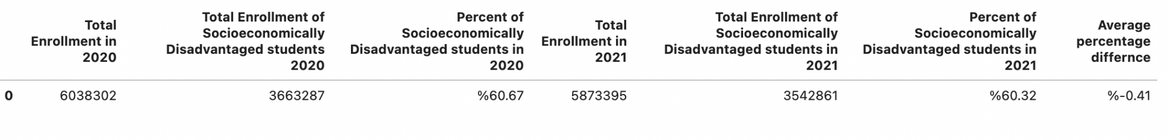
Socioeconomically Disadvantaged students
Summary Table
From the summary table above, we have the average percentage difference from all counties in California of socioeconomically disadvantages students enrollment percentage is -0.41%.
11

Slide 27
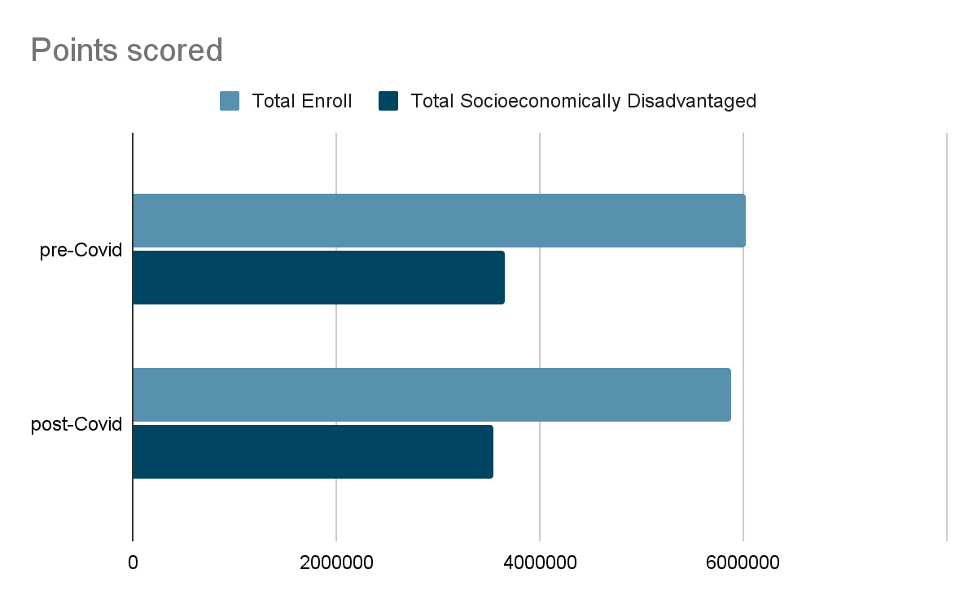
Socioeconomically Disadvantaged students
Graphic Summary
11

Slide 28
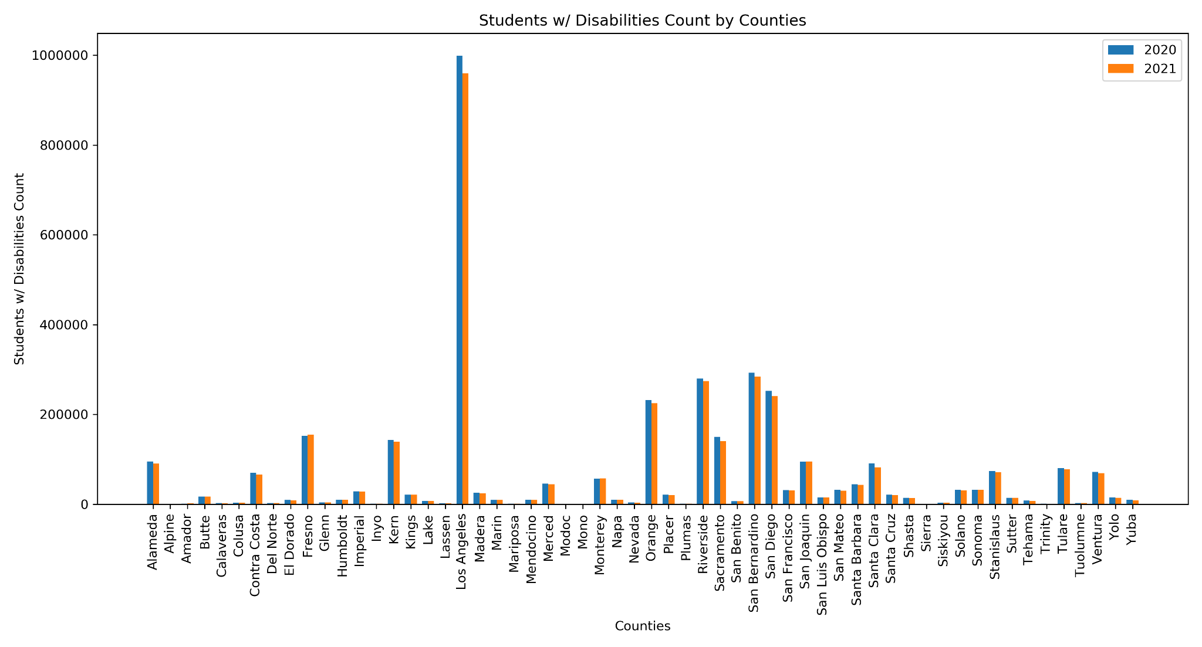
Socioeconomically Disadvantaged students
Graphic Summary
11

Slide 29
COVID vs.
Enrollment

Slide 30
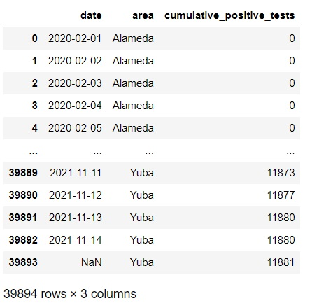
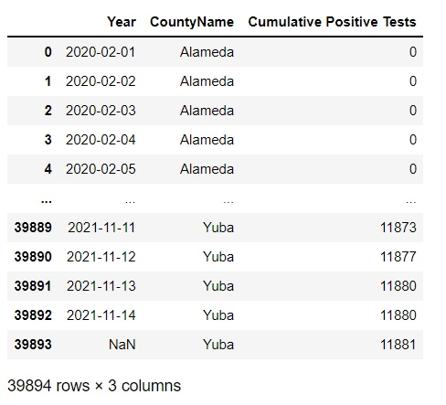
Cleaning of CA COVID-19 Cases Data
30
Notes:
Bryan -
(Left image)
Determined a new data frame to reduce the number of columns required for the data cleaning.
The columns required are “date”. “area”, and “cumulative_positive_tests”
(Right Image)
Columns were renamed using the combinations of “.rename” function and “columns.={“
“data” to “Year” ; “area” to “CountyName”; “cumulative_positive_tests” to “Cumulative Positive Tests”

Slide 31
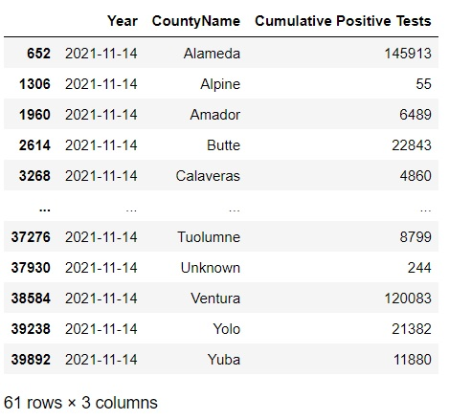
Contin. (Cumulative Positive Tests per County)
31
Notes:
Bryan -
Used the “.loc” function referencing the main data frame CA_county_cases to obtain total number of Cumulative Positive Tests for each county in CA.

Slide 32
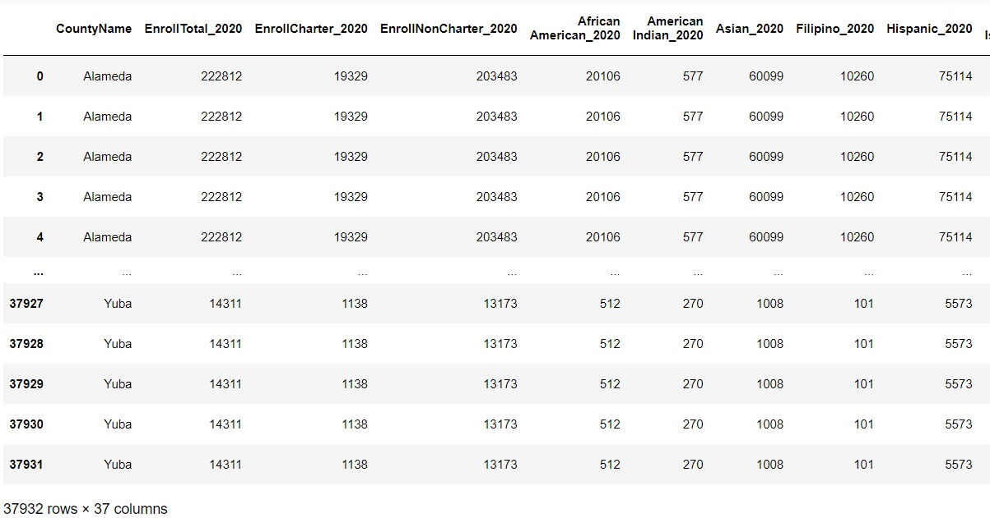
Contin. (Merge of Student Enrollment to COVID Cases)
32
Notes:
Bryan -
Used the “.merge” function to merge the student enrollment mentioned earlier in the presentation to the CA_county_cases data frame by using the column “CountyName”

Slide 33
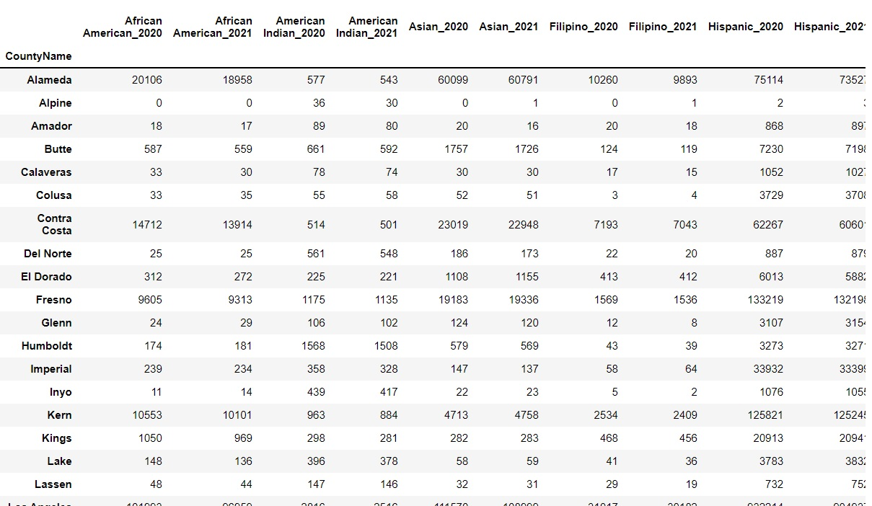
Reorganized by Student Enrollment
Part 1
33
Notes:
Bryan -
Reduce the Combined Data Columns to make comparison between ethnic groups vs COVID-19 Cumulative Positive Cases
Ethnic groups to be selected will be African American, American Indian, Asian, Filipino, Hispanic,
Pacific Islander, and White.
years referenced 2020 to 2021

Slide 34
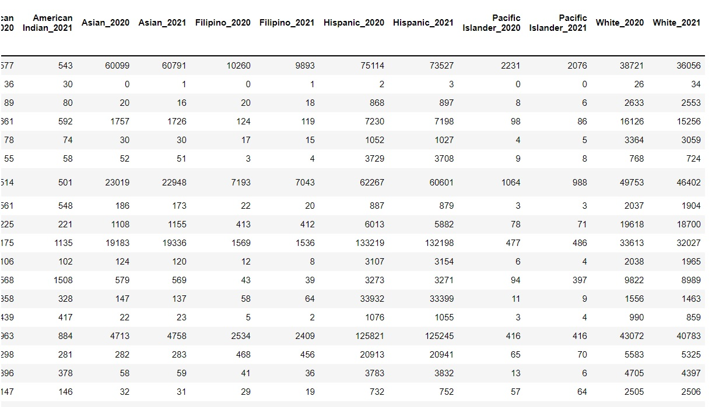
Reorganized by Student Enrollment
Part 2
34
Notes:
Bryan -
Reduce the Combined Data Columns to make comparison between ethnic groups vs COVID-19 Cumulative Positive Cases
Ethnic groups to be selected will be African American, American Indian, Asian, Filipino, Hispanic,
Pacific Islander, and White.

Slide 35
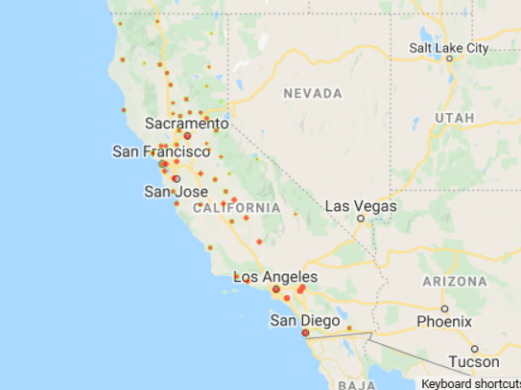
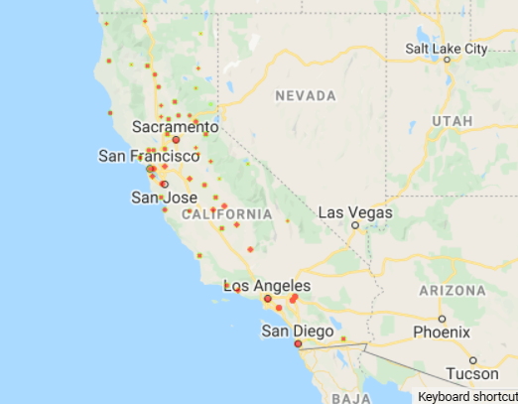
Heatmap for Total Enrollment for 2020 vs 2021
2020
2021
Notes:
For my part, I first plot a few heatmaps by using the gmaps function. The first ones I did were two heatmaps showing for Total Student Enrollment between the two years. As we see here, we can barely tell any difference between the two. That is because first of all the drop in student enrollment was not hugh enough to create a hugh difference in visualization. Moreover, it’s also because the two heatmaps were plotted separately with the data from two different years. The size of the dots are related to the counties. Overall, we have higher student enrollment in big counties such as SF, SJ, SD, LA, Sacramento, etc.

Slide 36
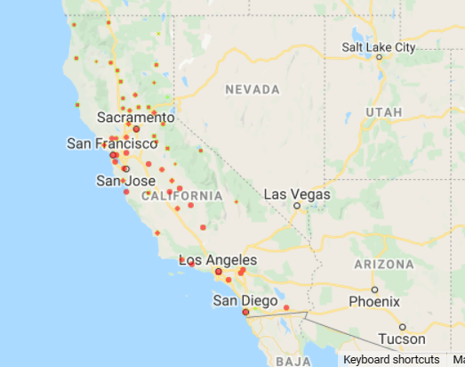
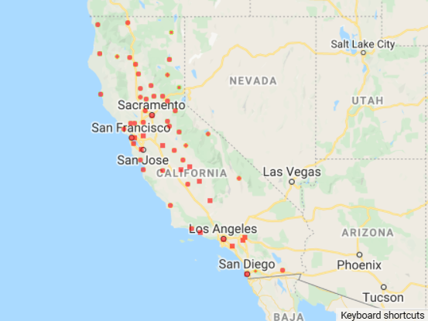
Heatmap for Cumulative Positive Cases 2020 vs 2021
2020
2021
Notes:
Next, I plotted the same heatmap using the cumulative positive covid cases for both 2020 and 2021 and got these two maps. For 2021, it’s the cumulative positive cases just for that one year. Here, we can tell a clear difference between the two maps. Overall, we have a lot more cases spread out to different counties in 2021 than in 2020.

Slide 37
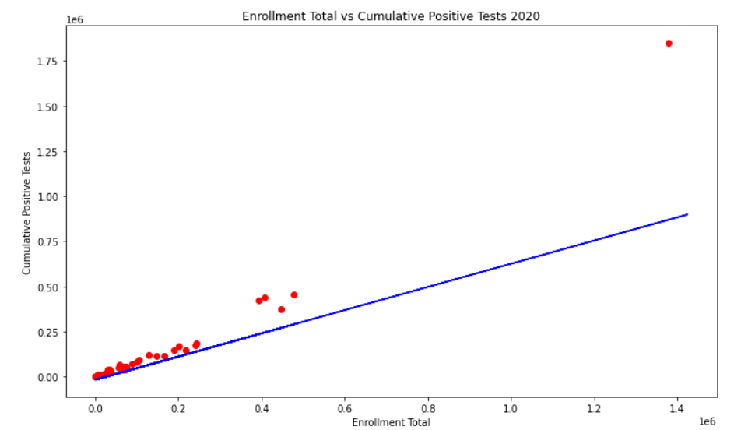
Linear Regression:
Enrollment Total vs Cumulative Positive Cases 2020
r = 0.97159388
R2 = 94.40%
y = 0.6434x - 17631.6
Notes:
After the heatmaps, I also conducted a linear regression between student enrollment total for each county and cumulative positive cases in each county. For 2020, we can tell from the graph that these two variables are positively correlated. It has a r of 0.97 which indicates a very strong positive relationship between the two variables. R2 is 0.944. In other words, 94.4% of the y variable is determined by the x variable. We got a linear regression equation of y = 0.6434x - 17631.6 with y being the cumulative positive cases and x being the student enrollment total.

Slide 38
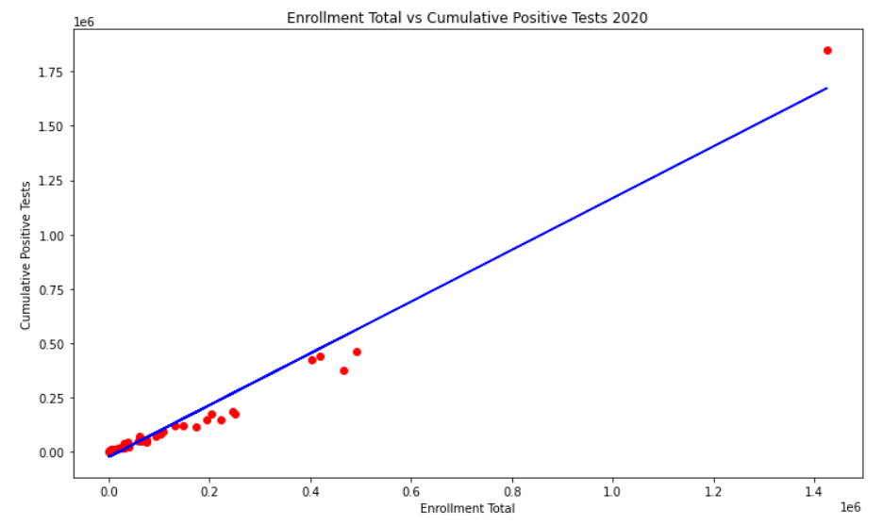
Linear Regression:
Enrollment Total vs Cumulative Positive Cases 2021
r = 0.98350271
R2 = 96.73%
y = 1.2309x - 25730.3
Notes:
Similar story here for 2021. We have a even stronger positive correlation between the two variables. r equals to 0.9835 and R2 equals to 96.73%. We have a regression equation y = 1.2309x - 25730.3. Although correlation doesn’t imply causation, it shows a strong relationship between the student enrollment and cumulative positive cases. It’s a good statistical foundation for us to continue the market research on how student enrollment is positively affecting the covid cases.

Slide 39
Summary
Was there significant change of enrollment pre-Covid vs during Covid?
Drop in total enrollment
Dependent on county
Did enrollment numbers change more for specific demographics?
Differed per demographic (i.e. Homelessness vs. Race)
Drop by demographic was overall even
Is there a correlation between COVID cases vs students enrolled?
Highly positively correlated
Does not imply causation
3
Notes:
Getting all of this info from edsource.org
In summary, our data analytics enabled us to find answers to the three questions we raised in the beginning.

Slide 40
Limitations to Data
The years on the data (2019-2020 & 2020-2021) do not correctly reflect the actual years.
Don’t have financial information per county for 2020-2021
Our Covid Cases data does not have data pertaining to demographics to do further comparisons
Unable to assess rural vs suburban areas
13
Notes:
Getting all of this info from edsource.org
While we had some good insights from our data, we also recognize some limitations on the data we use. For example, the years on the data sets do not correctly reflect the actual years. Secondly, we don’t have any financial info per county for 2020-2021. Third, our covid cases data does not have data pertaining to demographics to do further comparisons. Last but not least, we are not able to assess data for rural and suburban areas.

Slide 41
Questions?

